Slide 1

Certificate Generator
MCA-722
Project Presentation
MAY 2022
Utkarsh Gupta (192120009)
Internal Supervisor
Dr. Sanjay Sharma
Professor
Maulana Azad National Institute of Technology
Bhopal
External Supervisor
Mr. Pankaj Choudhary
Senior Technical Lead
Truminds Software Systems
Gurugram
Notes:
Good morning/afternoon/evening! I am pleased to present my major project for 6th semester, titled Certificate Generator. This is a part of my internship at Truminds Software Systems for past 5 months.

Slide 2


Company Profile
B2B
Licensable Software
Networking
AR
AI
Video Conferencing Platform
Online Exams Proctoring System
Large Scale Indoor Mapping
Network Traffic Routing Solution
Notes:
I’ll briefly talk about our company. We are mostly a Business-to-Business company and we make Licensable Software of all kinds. Truminds specializes in Netowkring, Augmented Reality and Artificial Intelligence. Here are some of the types of software Truminds has made for its clients, which include some big names like Panasonic, Qualcomm, Ikea and Vodafone. My project is intended for internal use at Truminds, and it is about…..

Slide 3



Digital Certificates
Trust based identity
I trust Smriti. I have her signature.
Smriti
Smriti’s Signature
Utkarsh
Unknown
Notes:
… Digital Certificates. Let me give you a small example of what digital certificates are. There are two people, Smriti and Utkarsh. Utkarsh has Smriti’s signature and he trusts smriti.

Slide 4

Digital Certificates
Trust based identity
Smriti
Hello Utkarsh.
I am Saurabh.
Utkarsh
@Hero
Notes:
If someone by the name of Hero comes along and says “Hello Utkarsh! I am Saurabh”, naturally, utkarsh will reply with:

Slide 5
Digital Certificates
Trust based identity
Smriti
I don’t trust you.
Utkarsh
@Hero
Notes:
I don’t trust you!

Slide 6
Digital Certificates
Trust based identity
Smriti
But Smriti says that I am the real Saurabh.
CERTIFICATE
@Hero is indeed the real Saurabh.
Signed by Smriti
Utkarsh
@Hero
Notes:
So Saurabh hands over a certificate to utkarsh and says that smriti signed this certificate and it says that Hero is the real Saurabh.

Slide 7
Digital Certificates
Trust based identity
Let me check if it’s the real signature.
Smriti
CERTIFICATE
@Hero is indeed the real Saurabh.
Signed by Smriti
Smriti’s
Signature
Utkarsh
@Hero
Notes:
Utkarsh now takes that certificate and compares its signature with the one he has.

Slide 8
Digital Certificates
Trust based identity
Yup it’s the same signature. I trust you now. Hi Saurabh!
Smriti
Utkarsh
Saurabh
Notes:
He concludes that the signatures match and since he trusts smriti he now also trusts this certificate, which means, this guy is indeed Saurabh. And that is more or less how digital certificates work.

Slide 9
Digital Certificates
Secure
SIGNED BY SMRITI’S PRIVATE KEY
“Signature” is a metaphor.
It’s an encryption key (a pair of keys) that provide the "signature-ness".
There is no concept of “forging” a signature.
DIGITAL CERTIFICATE
Name: Saurabh
Locality: Sector 18 Gurugram
State: Haryana
Country: IN
Hostname: realSaurabh.com
Validity: 06/02/2022 to 17/02/2022
Notes:
They are a document that identifies a person or a website or whatever the certificate has been issued to. The signature is just a metaphor. Nobody is scribbling down with a pen anywhere. They are actually a pair of encryption keys, aptly known as a private & a public key. There is no concept of forging a signature and “pretending” to be someone else. You can’t sign a certificate pretending to be someone if you don’t have their private key.

Slide 10

Certificate Generator
Digital Certificates Made Easy!
Notes:
My project aims to make the process of creating and singing certificates easy by default and customizable if required.

Slide 11

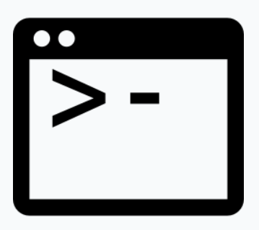

Certificate Generator
Graphical UI
Command Line
Python Library
Notes:
It is a collection of three toolsets – A graphical UI, A console program and a python library that allows people of all skill levels to easily create & sign digital certificates. Speaking of skill levels, that is how we started with the development of this software.

Slide 12
Requirements
Senior Executive
Knows absolute basics of what a Digital Certificate is.
Wants an easy & quick way to create & sign certificates.
Doesn’t need many customization options.
Has never used a Console.
…..
Project Manager
Knows about digital certificates and encryption keys.
Wants to quickly create or sign certificates in bulk quantities.
Knows shell scripting.
Needs some customizability.
…..
Backend Developer
Knows exactly what goes into creating a certificate.
Wants to embed digital certificate related functionality in his own project.
Needs as much customization as possible.
Knows programming.
…..
Notes:
We sat down with a senior executive who has not studied any computer science and just wants an easy way to sign certificates, a project manager who knows shell scripting and might need to sign a large number of certificates at once and a backend developer who might want to include these features into his own application and can do with as much customization as possible, and listed all their requirements. We further broke down all these requirements into small tasks with one person responsible for each task.

Slide 13
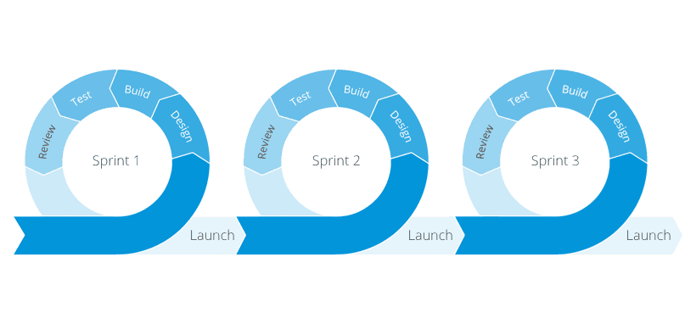
Action Plan
Agile Methodology
Notes:
And since Truminds is an “Agile Company”, we divided all those tasks into sprints, where each sprint lasts about 2 weeks and results in some meaningful work. Each sprint involves the whole development cycle – planning, coding and testing – all of it.

Slide 14
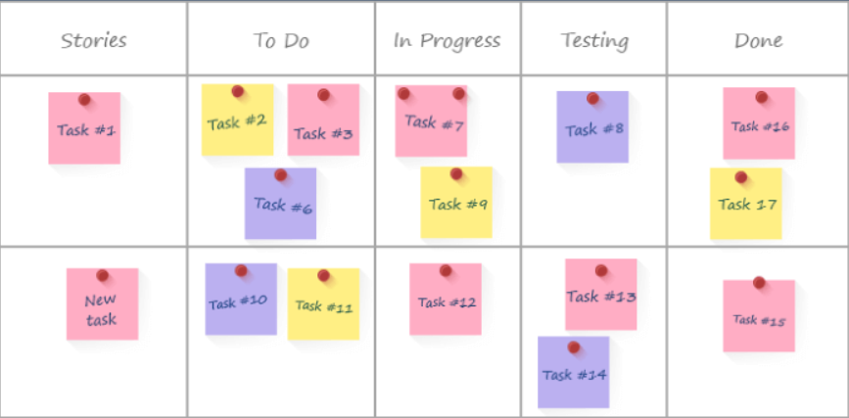
Action Plan
Kanban Tracking
Notes:
We also tracked the progress of each task using a Kanban board to make sure we’re not stuck somewhere. A Kanban board is made up of columns representing the state of the tasks - a card moves from first to the last column throughout its cycle. The project is considered complete when all cards have reached the “DONE” column.

Slide 15


Architecture
Argument Parser Library
CLI
Command Line Interface
Encryption Library
Core
Load, Create & Sign Certificates
Common
Common functions used by CLI & GUI
Logger
Log important events
GUI
Graphical User Interface
Graphics Library
Notes:
An important task was coming up with a modular architecture of the application. Our system is divided into fairly independent components. The CLI and GUI are the primary ways to use Certificate Generator. Logger simply logs any interesting events or errors so that if the user finds a bug, they can send us this log file and we’ll know what went wrong.

Slide 16
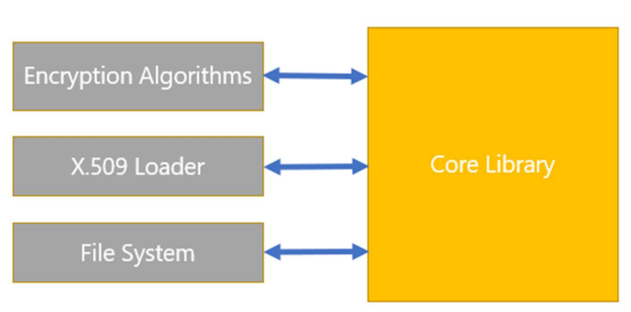
Core Libraries
Notes:
Speaking of the Core component, it is what drives the system. It interacts with the encryption algorithms, the x.509 loader – x.509 is the standard specification of a Digital Certificate and it also interacts with the file system to load certificates, keys and other things.

Slide 17
Common Modules
CORE
COMMON
PrimitiveOp1()
ComplexOperation:
PrimitiveOp1()
PrimitiveOp2()
PrimitiveOp2()
Notes:
Lastly, Core library has very primitive operations; the Common module abstracts some of this verbosity so that Console application and the Graphical application are easier to write.

Slide 18
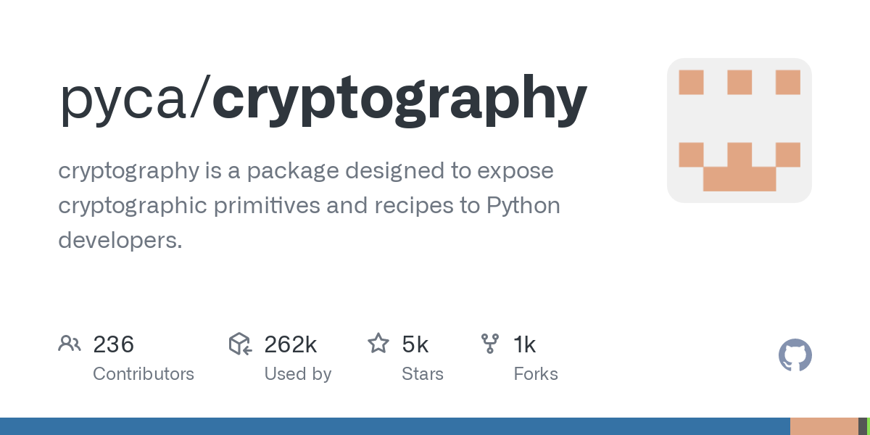
Implementation
Encryption Algorithms
X.509 Loader & Unloader
Notes:
Speaking of the implementation, of-course the software is closed source. But I can certainly discuss all the libraries that went into building it. Starting with pyCA/cryptography. It provides us encryption algorithms and methods to access X.509 certificates. However it is very low level, which requires us to build a proper object-oriented core library on top of it.

Slide 19
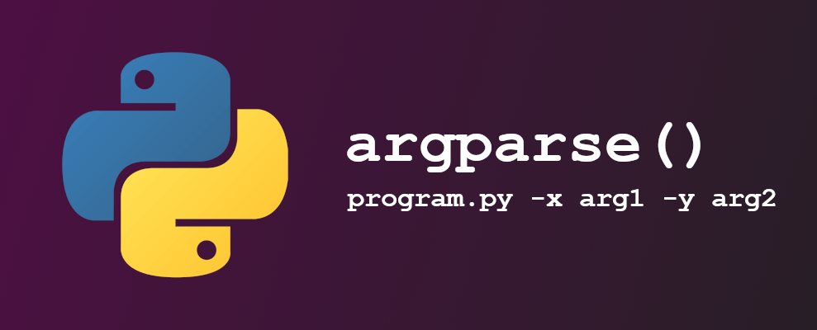
Implementation
Parses Command Line Arguments
program.py –x arg1 –y arg2
    args = {
    “x”: “arg1”,
    “y”: “arg2”
    }
Notes:
For the CLI, we have argparse library, it takes a console command and returns the command-line arguments as values in a python dictionary.

Slide 20
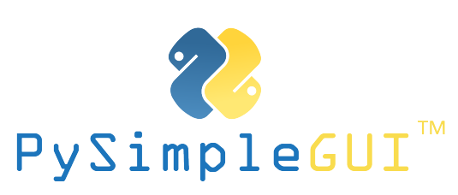
Implementation
Cross-platform graphics library
Separates UI from behavior
Both UI and behavior written in python
Notes:
For the GUI, we are using PySimpleGUI due to its cross-platform nature. It also separates UI from behavior very well, which is something other python graphical libraries struggle to do.

Slide 21
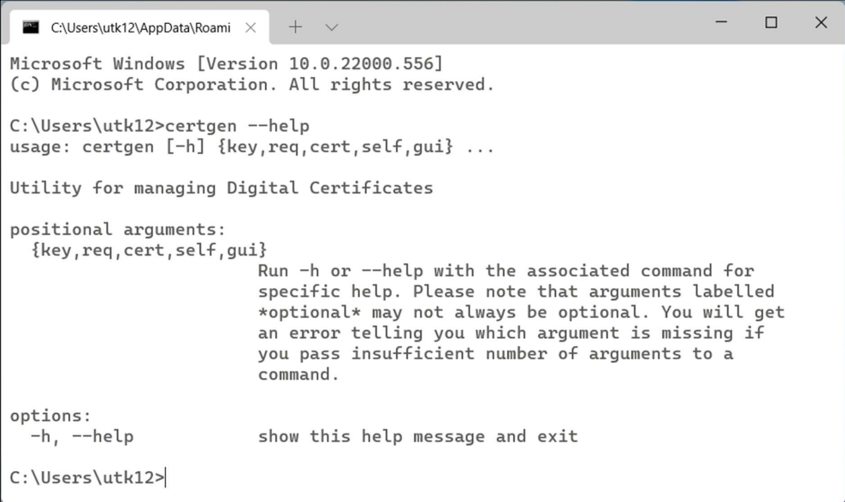
Command-Line Interface
Notes:
Finally, I’d like to showcase some important features of the software. A more comprehensive set of screenshots can be found in my project report. Our command-line tool is called “certgen”. Certgen has these useful --help commands which display everything that can be done via command-line.

Slide 22
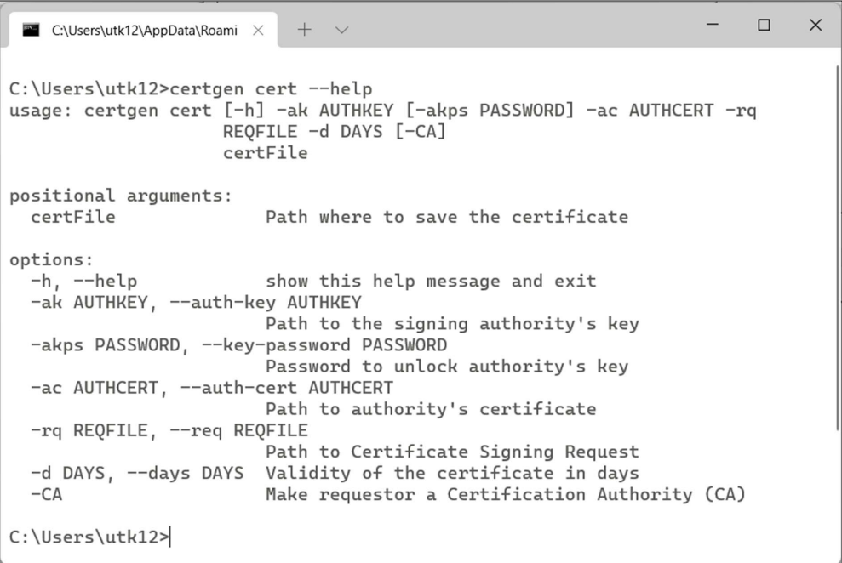
Command-Line Interface
Notes:
Here is an example of help regarding signing certificates. We can notice that there are two ways of doing the same thing. Indeed that is correct.

Slide 23
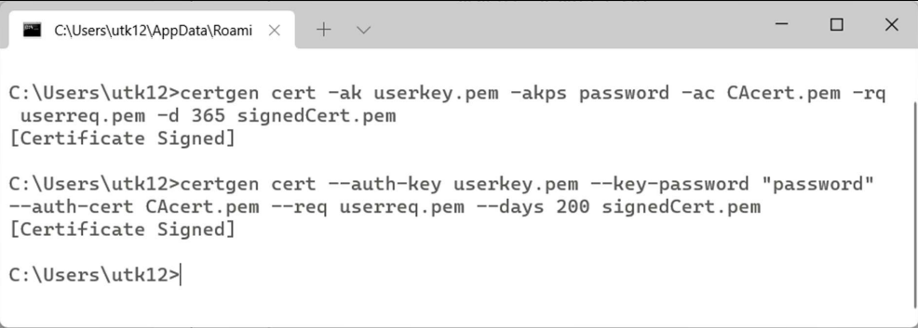
Command-Line Interface
Notes:
There is a long form and a short form for every command. CLI is very well documented because this is the most common use-case of our Certificate Generator.

Slide 24
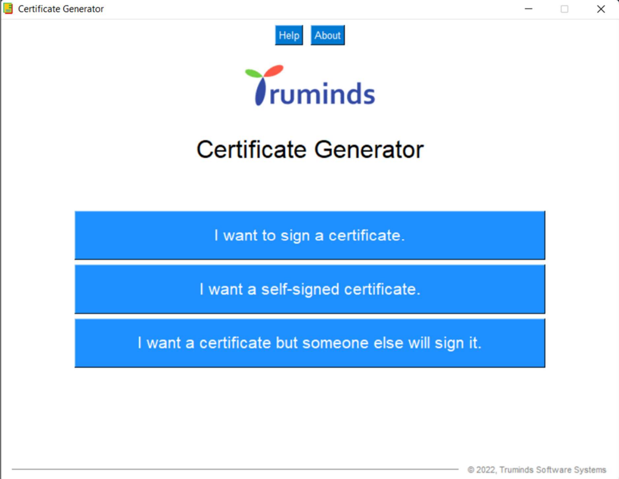
Graphical User Interface
Notes:
The GUI is built to be as easy as possible. The development of GUI went through multiple iterations to arrive at this simple user interface. Say, I am a senior executive and I just want to sign a certificate, I will go ahead and click on “Sign a Certificate”.

Slide 25
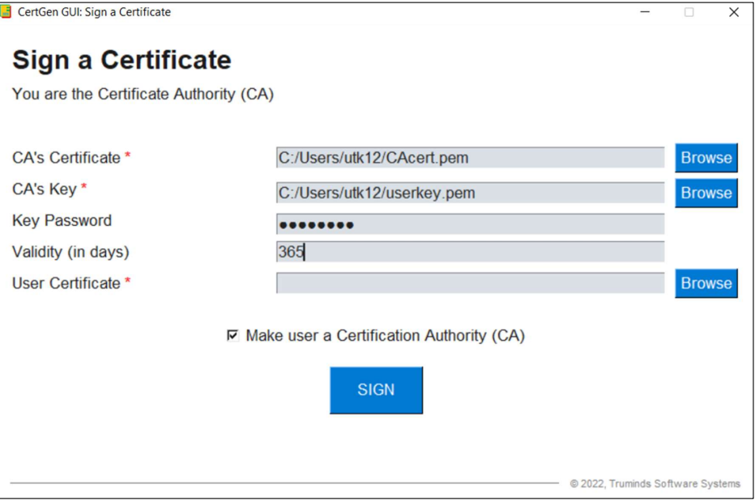
Graphical User Interface
Notes:
I get this very simple to use window, telling me exactly what all things are required to sign a certificate. There are almost no customization options through the GUI for the sake of simplicity.

Slide 26
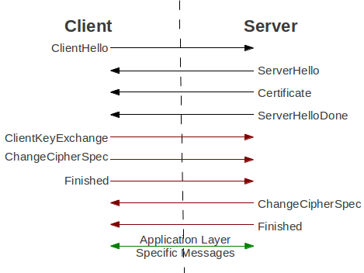
Is our program producing valid certificates?
TLS
Notes:
Finally, how do we know if our code is producing valid certificates? One common use-case of Digital Certificates is in the setup of a TLS Connection. TLS or Transport Layer Security is a protocol that is also the difference between HTTP and HTTPS. Security and identity management is something usually done at Session Layer, whereas this is done at a much lower level in the OSI model. So we cooked up a simple client and server connection using python-sockets and supplied it with certificates created using Certificate Generator. The connection was set up successfully. So how did we know it was actually TLS enabled.

Slide 27
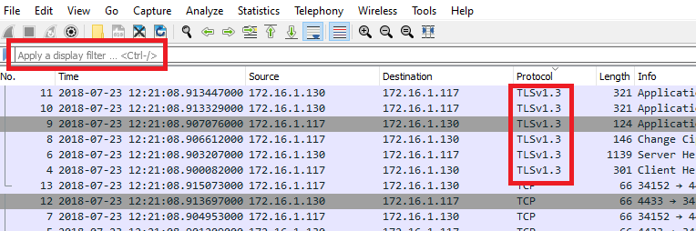
Is our program producing valid certificates?
Wireshark Capture
Notes:
This is where a packet capture software like wireshark comes. It intercepts all traffic going in and out of your system and we could clearly spot TLS packets being setup. Mission Accomplished.

Slide 28
Summary
Concept of Digital Certificates
Requirements
Action Plan – Agile Methodology & Progress Tracking
Architecture
Implementation
Results & Features
Testing
Notes:
To summarize, we started with the concept of digital certificates – we saw the different types of users who have different expectations from Certificate Generator – we took a brief look at the agile methodologies used – then we discussed the architecture of the application (Core, Logger, CLI, GUI and Common components). Finally we talked about the libraries used in the implementation of the software and took a quick look at some salient features of the Console & Graphical Certificate Generator. We ended with testing our certificates in a TLS connection setup.

Slide 29
Certificate Generator
MCA-722
Project Presentation
MAY 2022
Utkarsh Gupta (192120009)
Internal Supervisor
Dr. Sanjay Sharma
Professor
Maulana Azad National Institute of Technology
Bhopal
External Supervisor
Mr. Pankaj Choudhary
Senior Technical Lead
Truminds Software Systems
Gurugram
Notes:
With this I conclude my presentation. Thank you!

